Slide 1

My assignment presentation
Name : Gefy Aqiilah Aqshal
Class : Fullstack Website - 5

Slide 2
Task #1
2

Slide 3
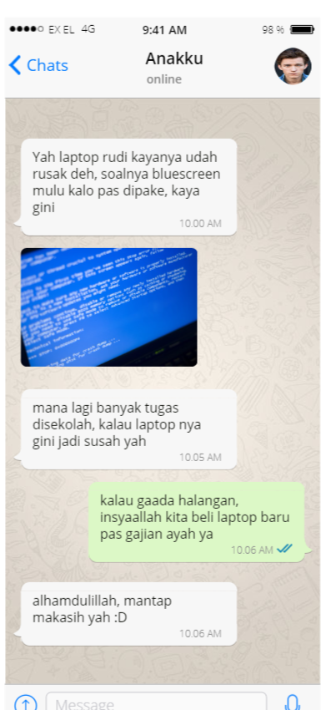

Slide 4



THANK YOU
WOODGROVE BANK
April Hansson
+1 23 987 6554
april@woodgrovebank.com
www.woodgrovebank.com

